Slide 1





DATA SCIENCE PROJECT
(Students Grading)
Supervised by: Pro.Nahla Barakat
Group 37
Amr Galal 235355
Ahmed Hany 236295
Toka El Sayed 232203
Mennatallah Mohamed 232117
Habiba Amr 235133

Slide 2
The Data
Personal Information
Academic Factors
Department
Attendance (%)
Midterm_Score
Final_Score
Assignments_Avg
Quizzes_Avg
Participation_Score
Projects_Score
Total_Score
Grade
Percentage
GPA
Study_Hours_per_Week
Extracurricular_Activities
Internet_Access_at_Home
Parent_Education_Level
Family_Income_Level
Stress_Level (1-10)
Sleep_Hours_per_Night
percentage of students receiving grade
Grade/mark
Assigned meaning
Student_ID
First_Name
Last_Name
Email
Gender
Age

Slide 3
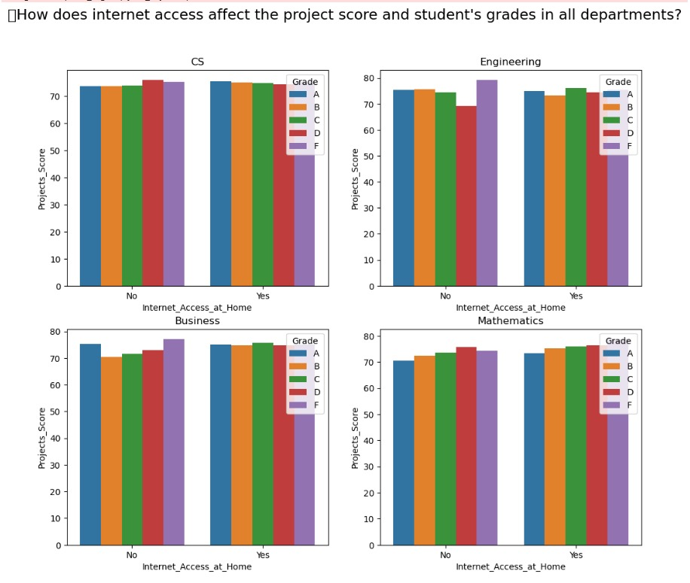
How does internet access affect the project score and student's grades in all departments?
-2 i used subplots for visualization in this question because it is the best way to show how internet access affect the grades and the Project Score of students in every department -I made it 2x2 to be able to show the 4 departments in the top left (221) is CS department and in the top right(222) the Engineering department and in the bottom left(223) is the Business dept and in the bottom right (224) the mathematic dept, -and in each barplot there is the Grades(A,B,C,D,E,F) in which it represent the internet access affect on each grade -This chart compares project scores and grades across departments based on internet access at home. -In most departments, students with internet access have slightly higher project scores. -For Engineering and Mathematics, scores are similar regardless of access. -Grades vary a bit, but there's no strong pattern linked to internet access. -Overall, internet access may help slightly, but it’s not a major factor across all fields

Slide 4
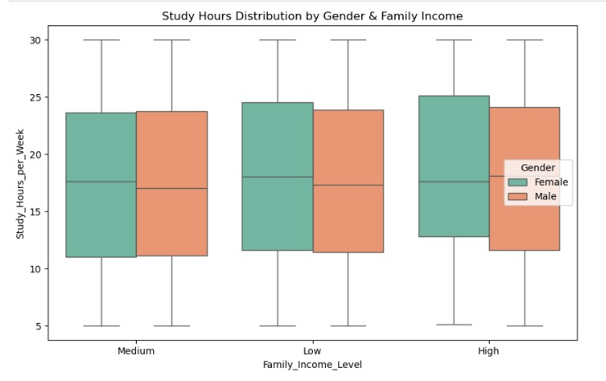
Does gender and family income play a role in study hours per week and total score?
-Check if gender and family income affect study hours and total score. -This chart shows how study hours per week vary by gender and family income level. -Female students tend to study slightly more than male students across all income levels. -The study hours are similar across low, medium, and high-income families. -The range of study hours is wide for all groups, with some studying much more or less than average. -Overall, gender has a small effect, but income level doesn’t seem to impact study time much.

Slide 5
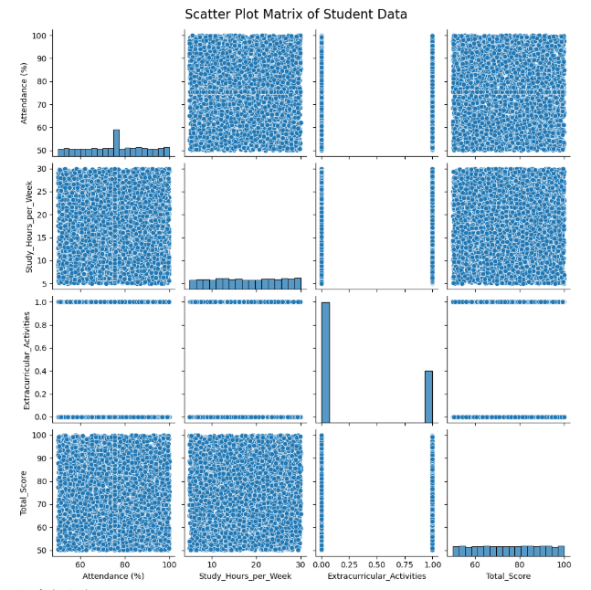
How do students’ attendance and study time together influence their participation in extracurricular activities and their total score?
-This chart compares student data like attendance, study hours, activities, and total score. -Each box shows how two things relate, and the diagonal shows how each one is spread. -Most dots are scattered, so there’s no strong connection between the factors and the score. -Attendance and study hours are spread out evenly among students. -Extracurricular activities only have two values: yes or no.

Slide 6
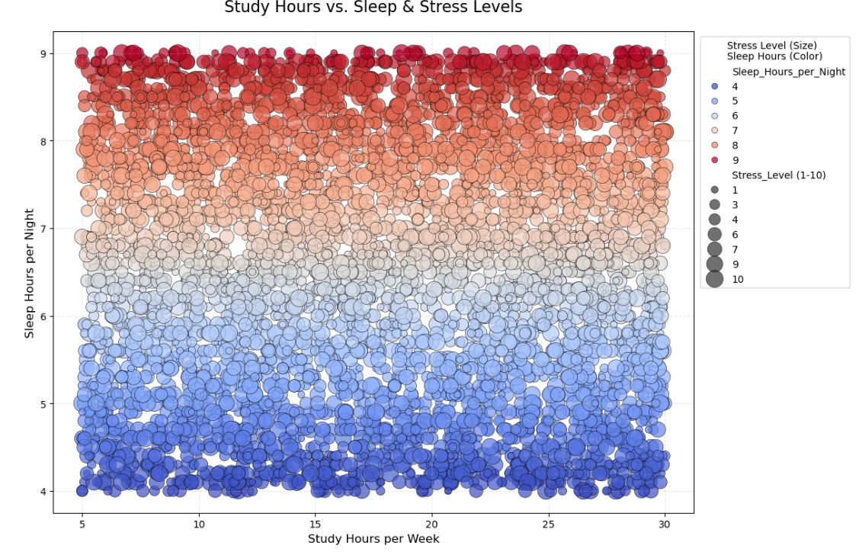
How studying hours impact the sleeping hours and the stress levels of the students?
-Explore how study and sleep hours relate to student stress levels. -The scatterplot shows study hours (x-axis),
sleep hours (y-axis), and stress (bubble size). -Color represents sleep hours, with red = more sleep and
blue = less sleep. -Students with less sleep generally report higher stress
regardless of study time. -The chart suggests sleep has a stronger effect on stress than study hours.

Slide 7
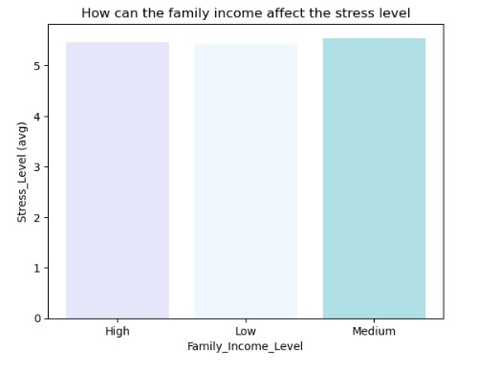
How can the family income affect the stress level and the effect of both affect the participation score and total score?
Part 1
-Let's plot the average Stress_Level of each value in the range from (1-10) of Family_Income_Level column -where stess level : family income (high:medium, low:low, medium:high).

Slide 8
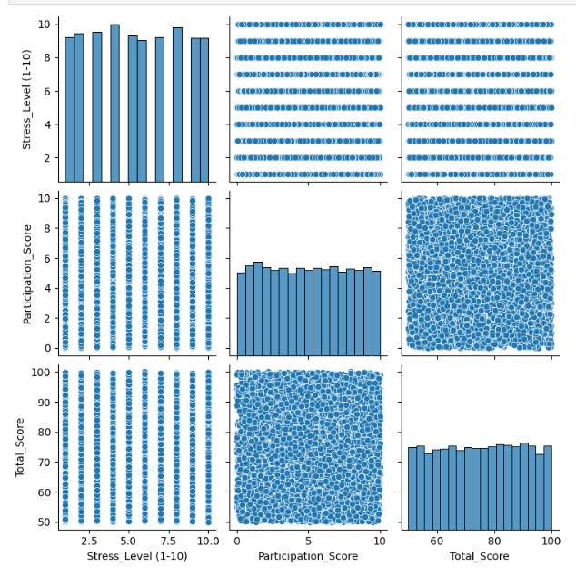
How can the family income affect the stress level and the effect of both affect the participation score and total score?
Part 2
-Using sns pair plot to show the affection of family income and stress level on participation and total scores, -and plot shows that stress level doesn’t significantly affect both participation and total scores. -How can the family income affect the stress level and the effect of both affect the participation score and total score?

Slide 9
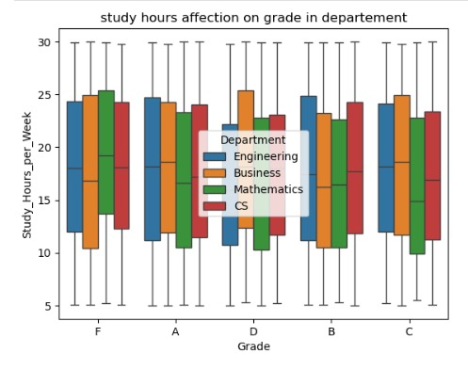
How can the average study hours affect the student's grade in different departments?
-How can the average study hours affect the student's grade in different departments? -using sns box plot shows that there is no strong correlation between grades and study hours as students who study more ---do not necessarily have better grades.

Slide 10
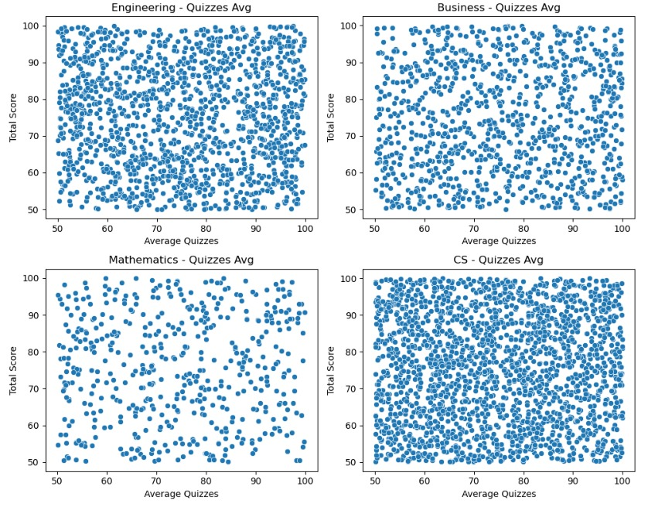
How the total score is affected by either the average quizzes or the projects score upon each department?
Part 1
-How the total score is affected by either the average quizzes or the projects score upon each department? -These scatter plots compare students' average quizzes score with their total scores across each department. -Each dot represents one student, showing their quiz average and total score. -Some departments show a slight upward trend, meaning students with higher quizzes average score often have higher total scores. -There's a lot of variation, especially in Business and CS, so other factors also affect total scores.

Slide 11
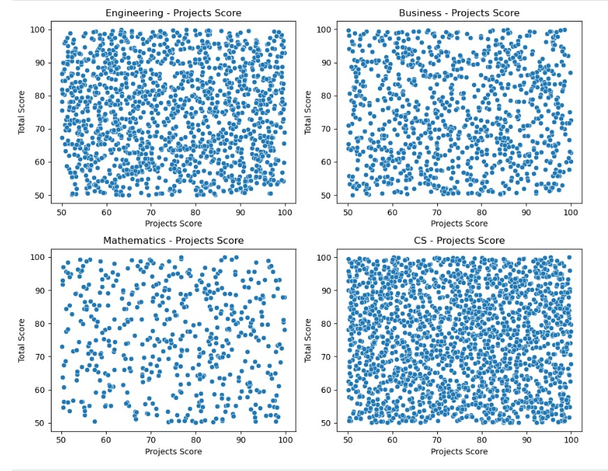
How the total score is affected by either the average quizzes or the projects score upon each department?
Part 2
-How the total score is affected by either the average quizzes or the projects score upon each department? -These scatter plots compare students' project scores with their total scores across each department. -Each dot is a student, showing their project and total score. -Project scoring indicates higher total scores in departmental data measurements. -There's still a wide spread, especially in Business and CS, meaning other factors affect the total score too.

Slide 12
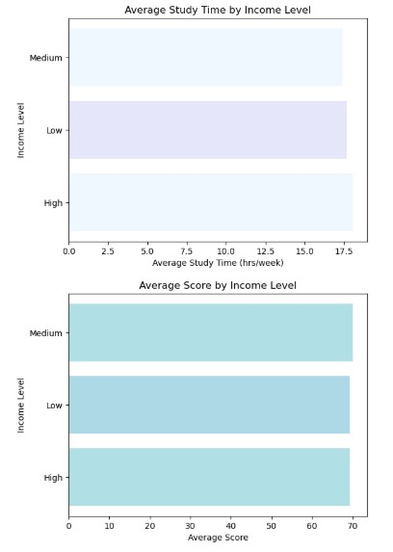
Do students from higher-income families study more and score higher than those from lower-income families?
-Visualizing the average study time for each income group using a horizontal bar chart. -Horizontal bars improve readability, especially if income levels have long labels. -A distinct color palette is used to make the chart visually clear.
-Plotting average final scores by income group to examine whether academic performance differs by income. -This visualization supports evaluating performance disparities linked to socioeconomic status.

Slide 13
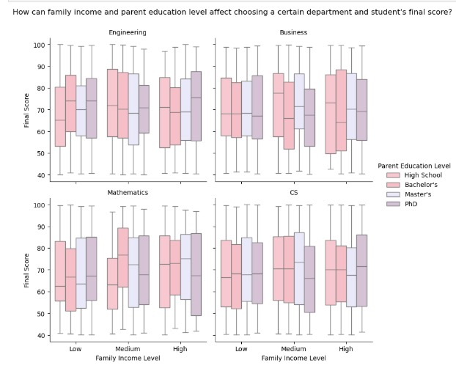
How can Family income and parent education level affect choosing a certain department and student’s final score?
-How can family income and parent education level affect choosing a certain department and student's final score? -These boxplots show how final scores differ across departments based on family income and parent's education level. -Each subplot represents a department. -Students with higher parental education and higher income show slightly better scores.

Slide 14
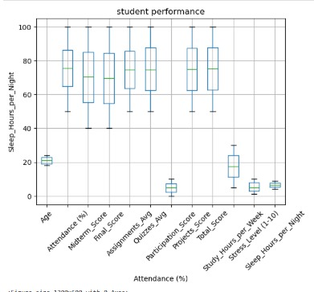
Does sleeping hours per night affect students' attendance?
-Do sleeping hours per night affect students' attendance? -Box plot to visualize the relationship between attendance percentage and sleep hours per night among students

Slide 15
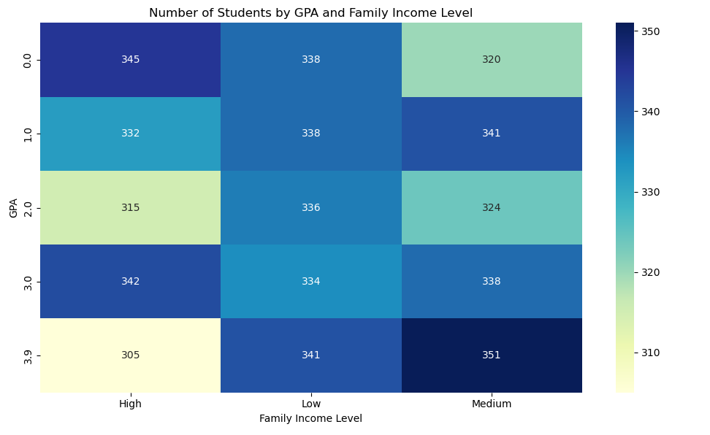
How do letter grades and their assigned meanings reflect students’ total scores across different departments?
-Q: What impact do Family Income Level and GPA have on a student's Assigned Meaning? -Visualizing the pivot table as a heatmap to make patterns easier -Heatmaps are effective for showing intensity or frequency distributions across two categorical variables.

Slide 16
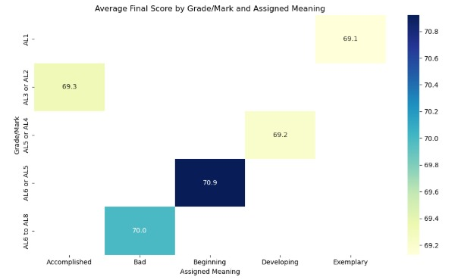
What patterns emerge between Grade/mark, Assigned meaning, Final_Score?
-What patterns emerge between Grade/mark, Assigned meaning, Final_Score? -This heatmap shows the average final scores for each combination of grade/mark and its assigned meaning. -Darker colors represent higher scores, and lighter ones represent lower scores. -For example, students in the 'A16 or A15' range with a 'Beginning' meaning scored highest on average 70.9. -This helps us compare how assigned meanings relate to actual performance.

Slide 17
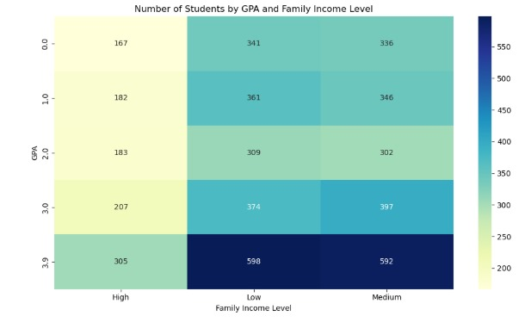
What impact do Family Income Level and GPA have on a student's Assigned Meaning ?
-Analyze how GPA and family income level relate to student counts.
-This heatmap shows student distribution across GPA and income levels.
-Higher GPAs (like 3.9) are more common in low and medium-income groups.
-Low-income students have the highest number at each GPA level.
-Family income seems to impact GPA distribution, with more low-income students excelling.

Slide 18
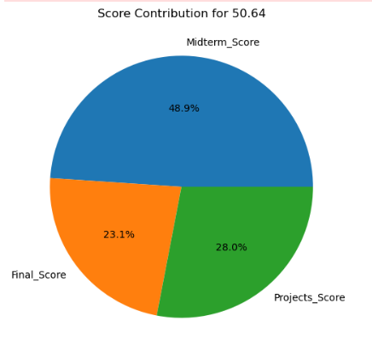
How do midterm score, final score and project score affect student's total score?
# Pie chart for the first student in the dataset that shows the contribution of each one of the midterms, final and project scores to the total score, where contribution is arranged in descending order (midterm>projects>final).

Slide 19
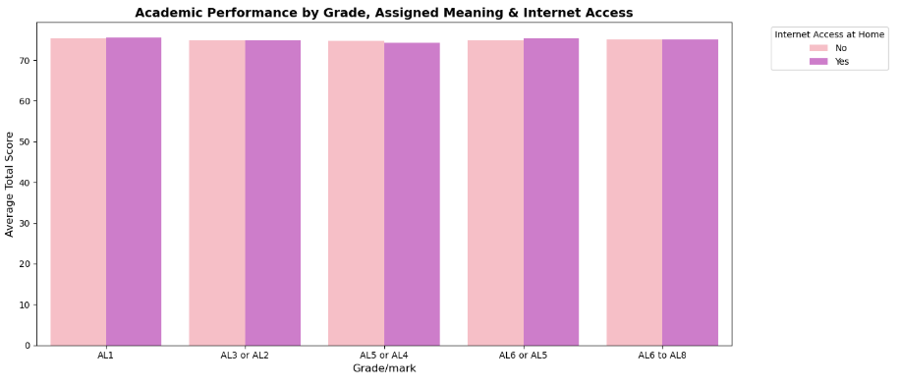
How do Grade/mark, Assigned meaning, and Internet Access at Home relate to academic performance?
# Grouping the data by students' letter grades, whether they assigned meaning to their studies, and their internet access at home.# This allows us to compute the average academic performance (Total_Score) across different combinations of these factors.# The goal is to explore how external (internet access), internal (assigned meaning), and formal (grade) factors interact.

Slide 20
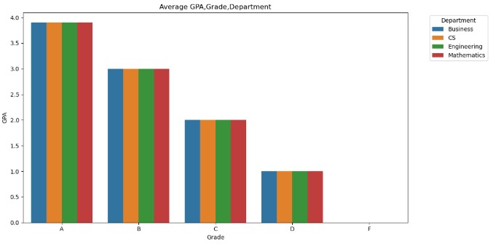
How does student's attendance affect their final grade and GPA in different departments??
Part 1
-use barplot visualization with seaborn to plot the relation between the grade and the average gpa in every department, --where the plot shows that higher grades students have higher GPAs, and there is no difference between departments

Slide 21
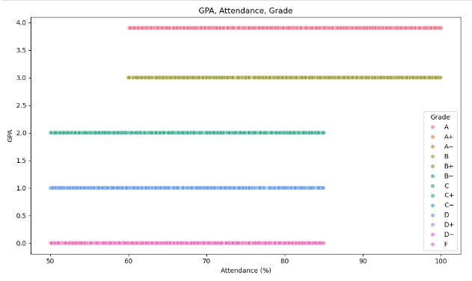
How does student's attendance affect their final grade and GPA in different departments??
Part 2
-use scatter plot visualization with seaborn to plot the relation between the gpa and the attendance percentage by each grade -And the plot shows that students with higher attendance percentage have higher GPAs

Slide 22
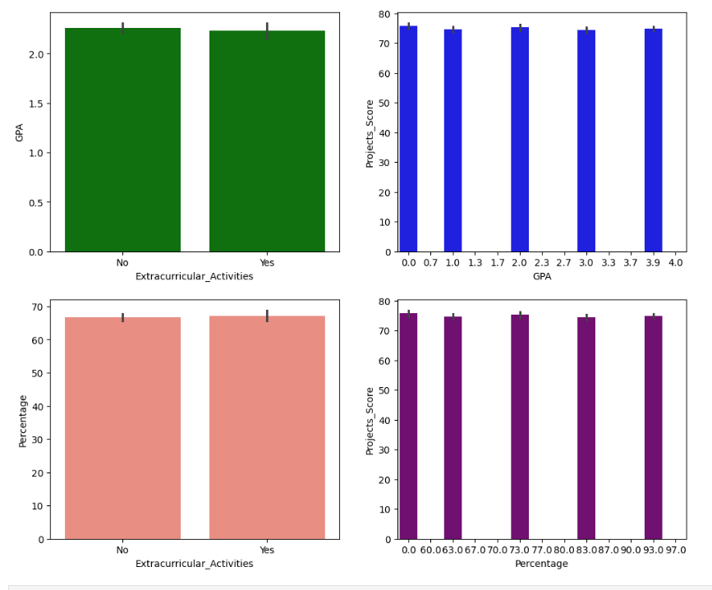
How does the extracurricular activities and project's score affect the GPA and the precentage of the students?
-How does the extracurricular activities and project's score affect the GPA and the precentage of the students? -The visualization compares GPA and project scores between students with ("Yes") and without ("No") extracurricular activities. -Students with extracurricular activities generally have higher GPAs (around 1.0-1.5) compared to those without (around 0.0-0.5). -Project scores are also higher for students with extracurriculars, ranging up to 4.0, while those without peak around 2.0. -The percentage distribution shows that participation in extracurriculars correlates with better academic performance. -Overall, extracurricular activities appear linked to improved GPA and project outcomes.

Slide 23
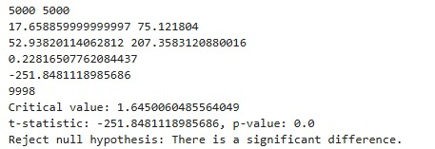
Hypothesis testing: (T test)
Study hours per week do not affect total student scores
Critical Value:
1.6450060485564049
T-statistic:
-251.8481118985686
P-Value:
0.0
Reject null hypothesis: There is a significant difference.

Slide 24

THANK YOU

